Slide 1
RMDV² User Training Course Guide

Slide 2
Course Schedule
09:00 Requirements Management in DOORS
10:30-10:45 - Break
12:30-13:00 - Lunch
13:00 Verification & Validation in Team Concert and Quality Manager
14:15-14:30 - Break
16:00 Finish

Slide 3
Course Units
RMDV² Overview
DOORS Basics
Requirement Modules
Classify Requirements
Synchronise Requirements (to RTC) for Testing
Writing Programme Requirements
RQM Basics
DOORS RMDV² Views and Links
RTC Basics
RTC Work Items
Create Test Tasks (DVP Creation)
Schedule Tests
Run Tests
Capture Test Results
Validate Requirements

Slide 4
Training Logins
Training logins are numbered 1 to 15. For example:
Login: training1
Password: Cloud123
The trainer will allocate your training number at the start of the course
Within the course, everyone will be working on a individual version of the A13 Climate and Comfort requirements module. The number of your allocated team is the same as your training login number
i.e. A13-01 Climate and Comfort

Slide 5
RMDV² Overview

Slide 6
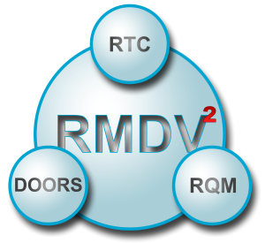
RMDV² Overview
RMDV² stands for Requirement Management and Design Verification & Validation (RMDV²)
The RMDV² Solution comprises three integrated IBM applications:
IBM Rational DOORS – for Requirements Management
IBM Rational Team Concert (RTC) – for Design Verification and Validation planning
IBM Rational Quality Manager (RQM) – for Test Case Management
RMDV² is focused on the following business process improvements:
Improved management of requirements
Effective management of traceability between the various levels of requirements e.g. customer to system, subsystem to component, requirements to tests
Enhanced planning and reporting of tests and associated Design Verification Plans (DVPs)
Impact analysis of proposed requirement changes
Better alignment with industry standards and best practice and Systems Engineering

Slide 7
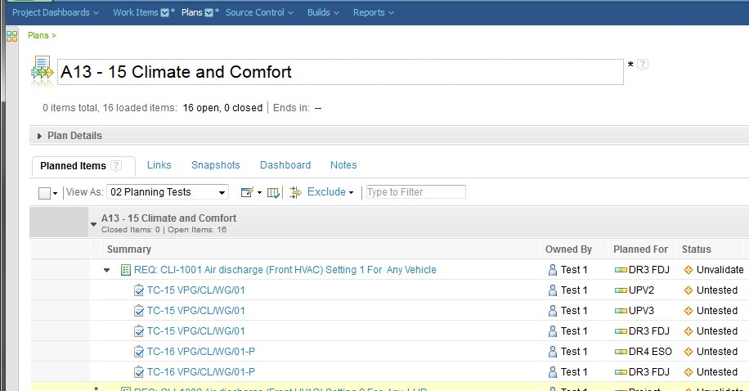
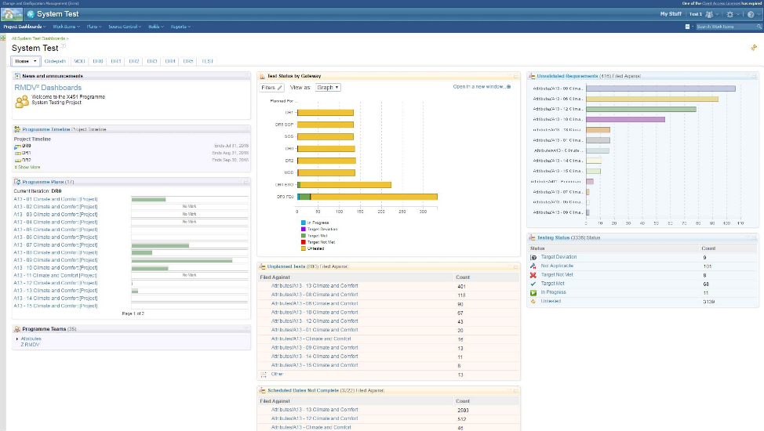
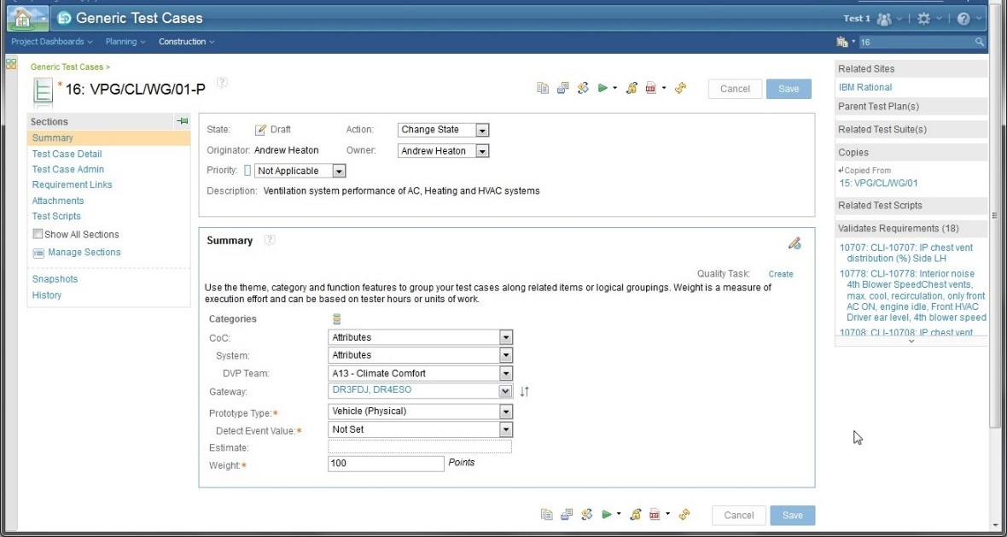
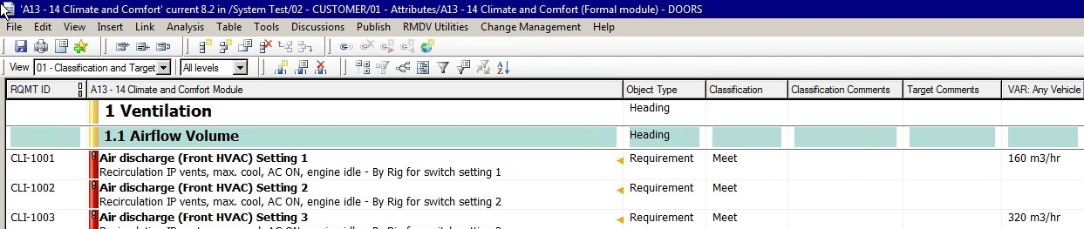
RMDV² Solution
RTC manages the test planning, results and reporting
The test plan is reported live
Requirements (tasks) are validated
Test tasks manage the scheduling of test cases and test results
RQM test cases are created to validate the requirement
DOORS requirements are authored, classified, and have targets captured against variants
Requirements are linked to test cases for validation

Slide 8
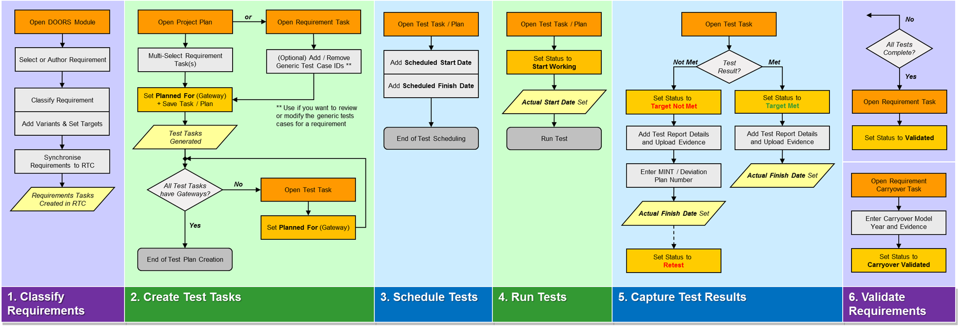
RMDV² Process
RMDV² is a six step business process:
Steps 1 and 2 are undertaken within the initial programme planning phase
Steps 3 to 5 are undertaken within the gateway where tests have been planned and executed
Step 6 is undertaken at the validation gateway of the requirement – when all its tests are resolved
Step 1 is undertaken in DOORS. Steps 2 to 6 are primarily undertaken in RTC and RQM

Slide 9
Requirements Management in DOORS
Unit 1 – DOORS Basics

Slide 10
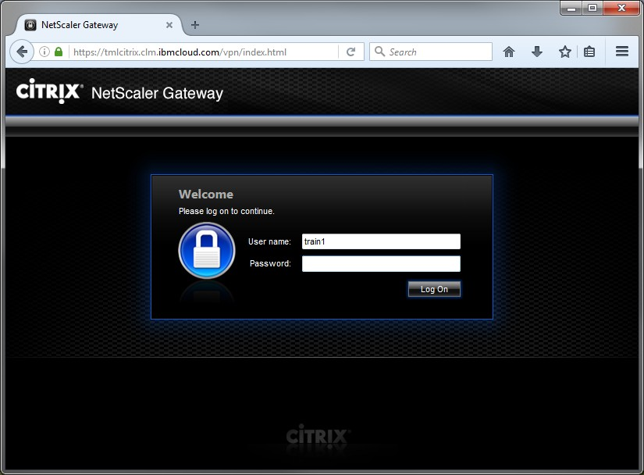
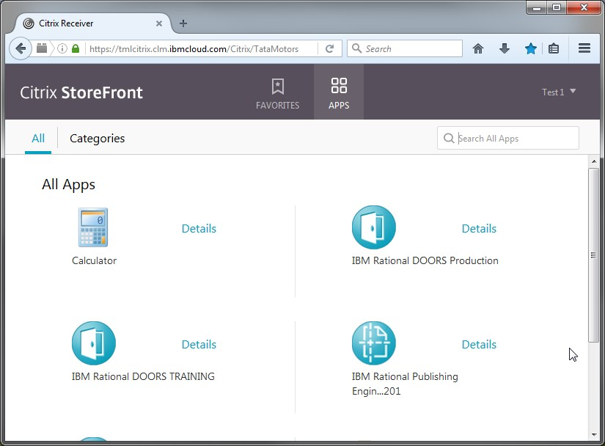
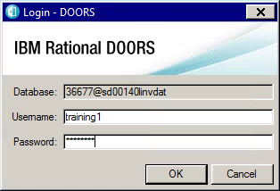
DOORS
DOORS is the Requirement Management system for RMDV², and is used for authoring programme requirements, receiving and reviewing generic requirements, classifying requirements and setting targets
Login to CITRIX by entering the URL into your internet browser: https://tmlcitrix.clm.ibmcloud.com/Citrix/TataMotorsWeb/
In the CITRIX Storefront, select the IBM Rational DOORS Training icon in Apps
Log into DOORS
Step 1 Step 2 Step 3

Slide 11
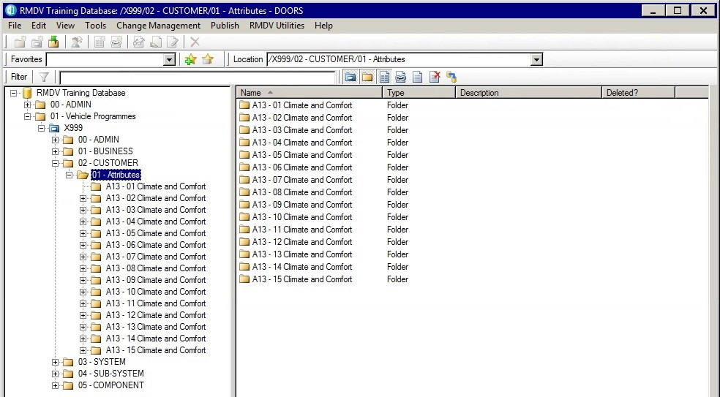
Database Explorer
The database explorer view shows the vehicle programmes in the database
Generic requirements are held in a generic library, which is used as the template for all new vehicle programmes. Generic requirements can only be added to the library after authorisation and are owned by a Generic Requirement Author
A vehicle programme is a snapshot copy of the generic library
The 00-ADMIN folder holds the Generic Requirements library
Each Vehicle Programme has its own project (i.e. X999 for training)
Each DVP team has its own requirements folder

Slide 12
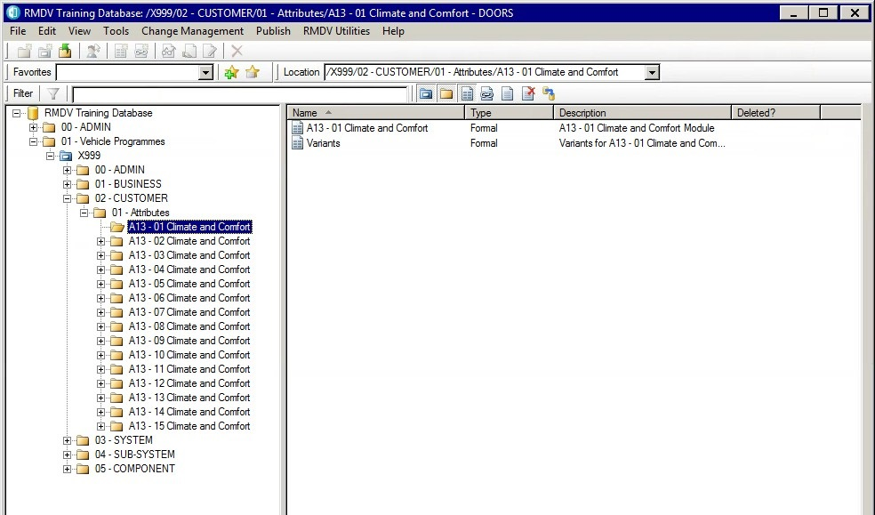
Requirement Modules
Requirements are managed by Design Verification Plan (DVP) team; there are two modules in each teams folder in DOORS:
DVP Team requirement module (uses team name) – which holds a team’s requirements
Variants module – which holds the list of feature variants applicable to that DVP team
Each DVP Team has its own Requirements module and Variants module
The Variant module is read-only as is created by RMDV² Administration on programme set-up and is not editable by a standard user

Slide 13
Exercise
Please complete the Unit 1 Exercise

Slide 14
Unit 2 – Requirement Modules

Slide 15
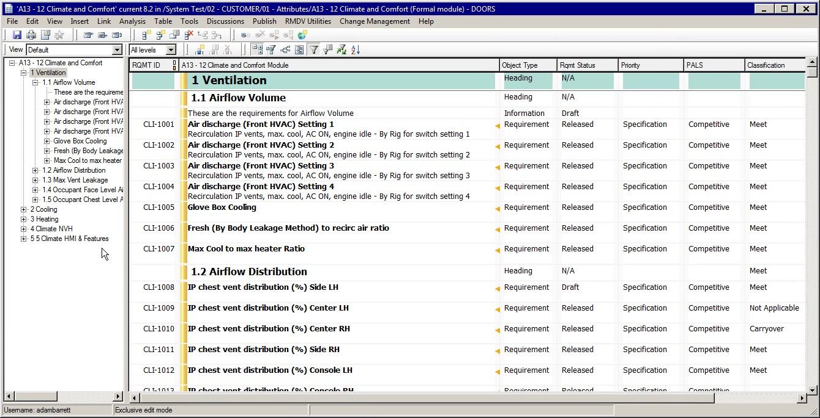
Navigation
Menus and Icons
Module Explorer
This can be hidden in the menu:
View > Module Explorer
Activity Window

Slide 16
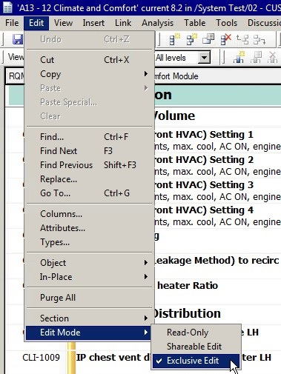
Edit Modes
By default, when you open (double-click) a module it opens in read-only mode
To change to exclusive edit, open the module and select Edit > Edit Mode > Exclusive edit
Edit modes can be switched between exclusive edit and read-only as required
There are two edit modes used
(Shareable edit is switched off by default)
Read Only – Users can view the module but not change anything (default state)
Exclusive Edit – Users can view and edit the information in the module
Note: only one person can edit a module at one time

Slide 17
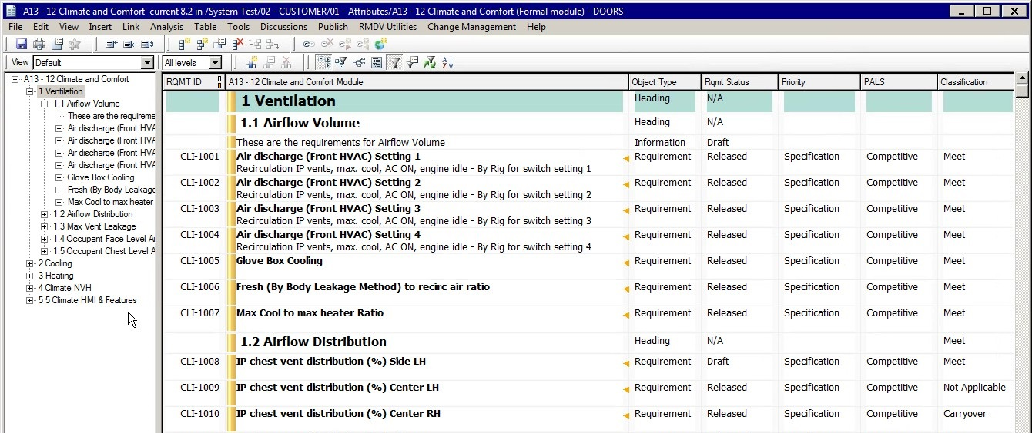
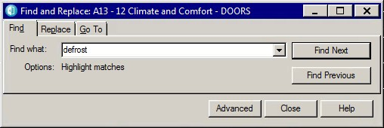
DVP Team Requirement Module
The DVP Team requirement module holds the requirements and information for that team
Requirements are organised hierarchically, in a familiar document-style list, and with each requirement shown in context
A tabular view of the requirements helps you view and assign additional information to them using attributes
Attribute
Heading
Information
Requirement
REQ ID
Change Bar
Use Control-F to find objects

Slide 18
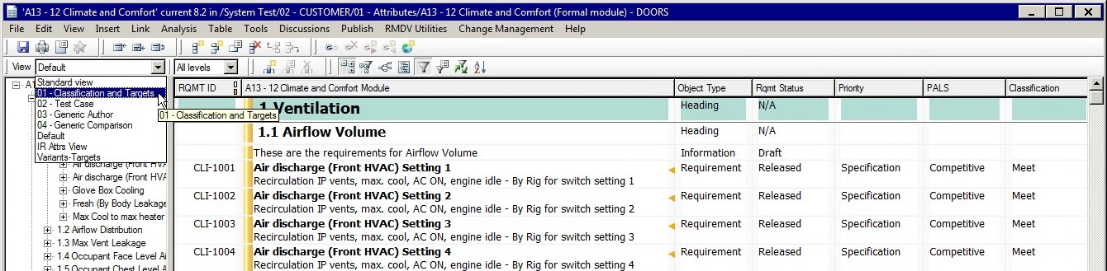
Requirement Views
A number of pre-defined DOORS views have been created for RMDV² to aid the user through the process.
A view is simply a filtered view of the DOORS attributes
Attributes belonging to the Default view
View Selection
View | Description
Standard | The base DOORS view included with every module
01 Classification & Targets | Used for classifying requirements and recording targets
02 Test Case | Shows the 'Assigned Test Cases' against Requirements with links to RQM
03 Generic Author | Shows all the information for creating requirements (programme and generic)
04 Generic Comparison | Shows the generic requirement with its program version (for comparison purposes)
Default View | Displays a generic set of attributes for reviewing and authoring requirements
Display Variants | Contains the full list of variants and links to RTC Planning tasks (admin view)

Slide 19
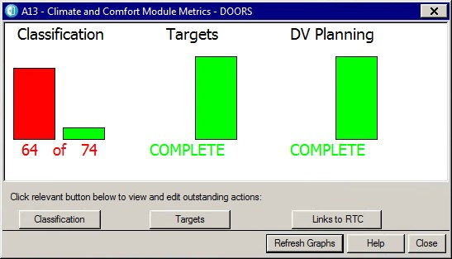
Module Metrics
Module metrics allows users to check on the status of their DVP completion tasks.
This function can be found on the menu option: RMDV Utilities > RMDV Scripts > User > Module Metrics
Number of generic (released) requirements not classified (red bar)
Number of classified requirements without target variants
Number of requirements not synchronised to RTC for test planning

Slide 20
Exercise
Please complete the Unit 2 Exercise

Slide 21
Unit 3 – Classify Requirements

Slide 22
Process Step 1: Classify Requirements
The process flow for classifying requirements in DOORS and sending them to RTC for testing is as follows:
Open DOORS Module
There are two types of requirements:
Generic requirements, which are automatically transferred into your requirements module at programme set-up
Programme requirements, which are authored on the programme
Select or Author Requirement
Classify Requirement
Add Variants & Set Targets
Requirements need a classification status and target value:
All requirements are classified for applicability
Requirements are assigned a target for validation testing
Targets are assigned to specific feature variants
Synchronise
Requirements to RTC
Requirements Tasks
Created in RTC
Requirements need to be validated through testing:
Requirements with a valid target, or have been classified as carryover are synchronised to RTC for validation by testing
1. Classify Requirements

Slide 23
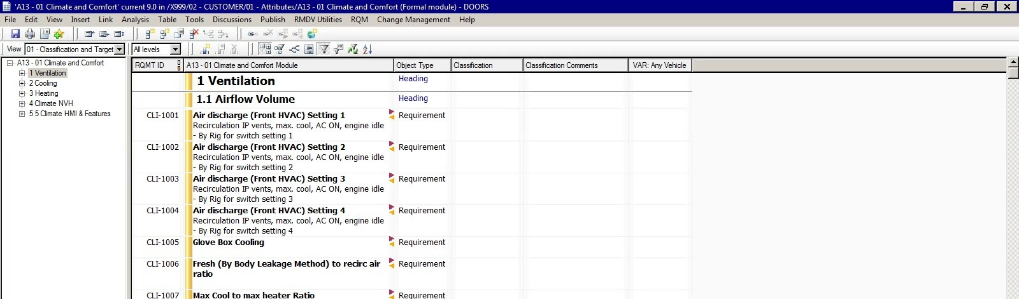
Classification and Targets View
The 01 Classification and Targets view is used for classifying requirements and setting targets.
At set-up, only the VAR: Any Vehicle target is available in the view
Classification state
VAR: Any Vehicle

Slide 24
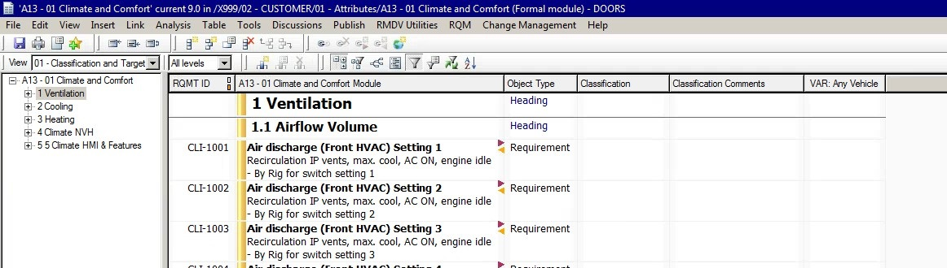
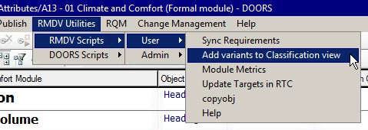
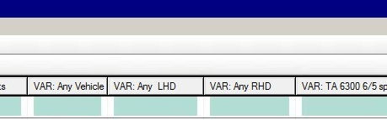
Add Feature Variants
Requirements can have multiple targets if the requirement target is different for specific feature variants
For example, the kilometres per litre (kmpl) target for engine types is likely to be different
Before starting classification, the variants need to be populated into the 01 Classification and Targets view.
Select from the menu: RMDV Utilities > RMDV Scripts > User > Add Variants to Classification View
The variant attribute columns are auto-populated. (This list can be amended to add/ remove variants as required)
Variants are populated from the Variants module which is created at programme start
If you need to test for additional feature variants then these can be requested from the RMDV² Administration team

Slide 25
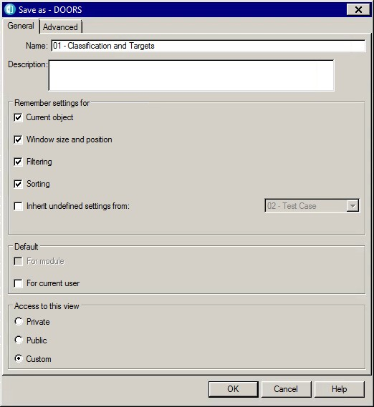
Changing and Saving the 01 Classification and Targets View
As a housekeeping exercise, the attribute columns in the view can be re-ordered, removed, added, or changed in width
Remove an attribute column by right-clicking on the variant column name and select: Remove
Add an attribute column by selecting from the menu: Insert > Column
From the drop-down list, select the required variant (i.e. VAR: XXX) and Insert it into the view
Modified views need to be saved to preserve the changes
To save a view, select: View > Save As – Click OK
View > Save As

Slide 26
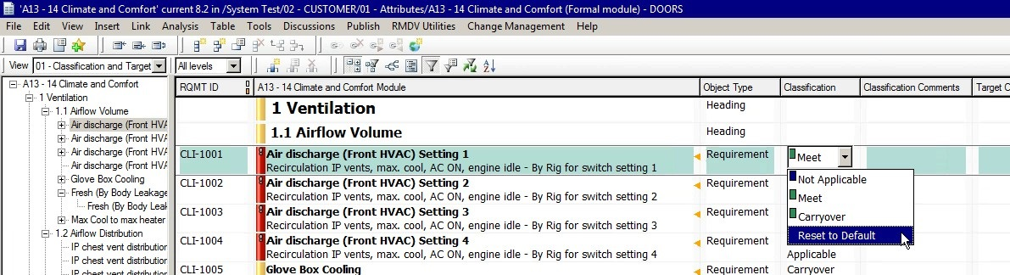
Classify Requirement
Classification is undertaken to review all the requirements in the module so only those applicable to the programme are accepted
Requirements are classified into the following states:
Meet - Requirement will be met by the owner
Carryover - Requirement is a carryover of an existing requirement and was previously validated in another vehicle programme
Not Applicable - Requirement is not-applicable to this vehicle programme
All requirements classified as Not Applicable must have classification comments added

Slide 27
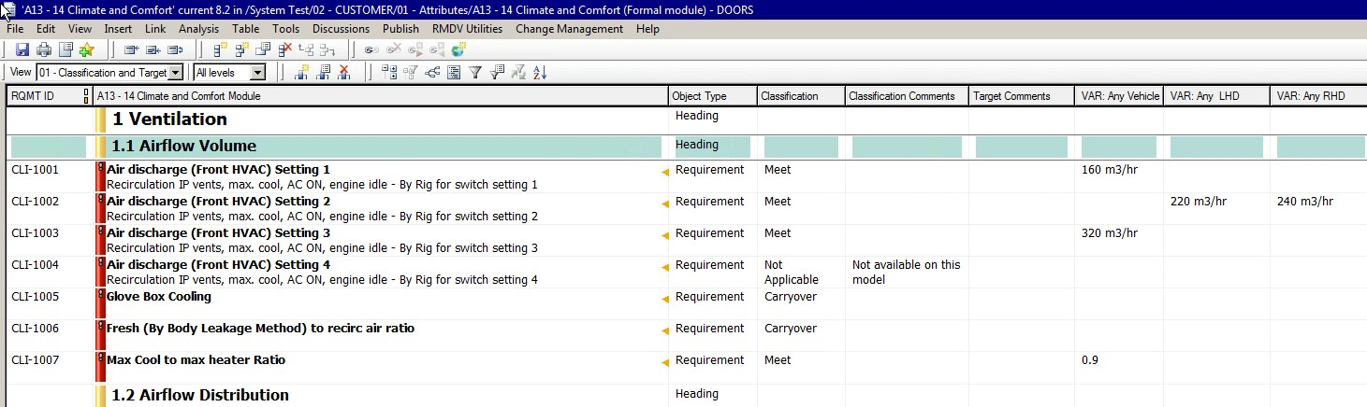
Set Targets
When a requirement has been classified, it is assigned a target by entering a target value into the appropriate feature variant column.
If a target is applicable for all variants, the target is entered into the VAR: Any Vehicle column
If a target is applicable for some variants, then VAR: Any Vehicle is left blank and targets are entered into the other variant columns
Requirements classified as carryover do not need a target
A target should contain up to four parts
(for example: = 2 m/s +/- 0.5):
A quantifier (i.e. =,<, >)
A target number or objective (i.e. 2)
Target units (i.e. m/s , m3/hr,)
Tolerance (i.e. +/- 0.5)

Slide 28
Exercise
Please complete the Unit 3 Exercise

Slide 29
Unit 4 – Synchronise Requirements (to RTC) for Testing

Slide 30
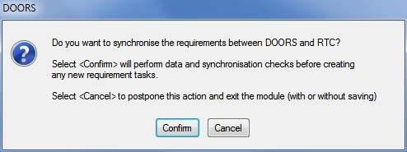
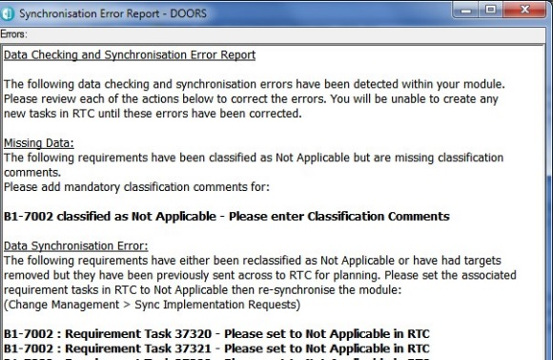
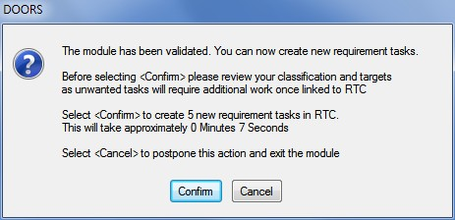
Preparing Requirements for Verification & Validation
All requirements that fulfil the validation rules for classification and targets are ready to be transferred to Rational Team Concert (RTC) for test planning
The requirement needs to fulfil the following validation rules:
Classified as Meet or Carryover
Is in a Released state.
Has at least one target in a Variant (VAR) column.
Once these conditions have been satisfied, the requirement can be transferred to RTC
This is triggered when the requirement module is closed or by selecting the menu option: RMDV Utilities > RMDV Scripts > User > Sync Requirements
User selects
<Sync to RTC>
Confirm
Confirm
Validation Report
System checks for errors and creates variants
Sync
Errors?
Yes
No
User is returned to module
Confirm
Confirm
System sends
requirements to RTC

Slide 31
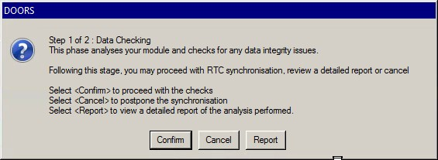
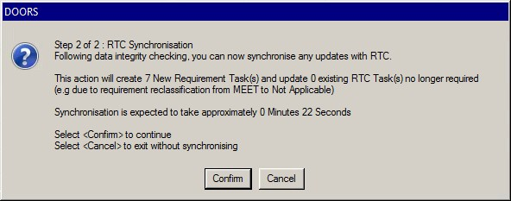
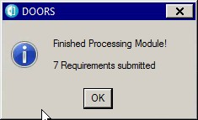
Synchronise Requirements
Selecting Sync Requirements starts a two-step process:
Step 1 of 2: Data Checking
The module is checked for data integrity issues. At this point, the user can view a report of all data to be transferred, confirm to proceed or cancel to exit
Step 2 of 2: RTC Synchronisation
The module has been checked and the requirements or changes are ready to be transferred to RTC for test planning
The menu will inform the user how long this transfer will take
Selecting Confirm will send the requirements to RTC
Synchronisation Complete
A confirmation box will display the requirements that have been processed and sent to RTC

Slide 32
Synchronisation Error Report
If the system finds errors in the quality of the requirements it will display a validation report, guiding the user on the actions required to correct the errors. Some examples of issues highlighted in the report are shown in the following table:
Classified Requirements with no Target: The following requirements have been classified but have no Targets set. Unable to create requirement task for WZ-10712, classified but no target found
Draft Requirements in Module: The following requirements are set to Draft in this module and will not be sent to RTC. Requirement WZ-10712 Status = Draft - This requirement will not be processed
ERROR: Missing Required Information: The following requirements have been classified Not Applicable but is missing mandatory information. The required information needs to be added to the following requirements in DOORS before RTC can be updated: Requirement CLI-1021 Classified as Not Applicable - Please enter Classification Comments
Work items to be deleted: The following requirements will be deleted and their associated Task and Test Tasks will be set to N/A in RTC: Requirement CLI-1004 will be set to N/A in RTC, REQ: CLI-1004 Air discharge (Front HVAC) Setting 4 For 1.5L CRAIL Engine Requirement CLI-1004 will be set to N/A in RTC, REQ: CLI-1004 Air discharge (Front HVAC) Setting 4 For 1.2L NG MPFI NA Engine

Slide 33
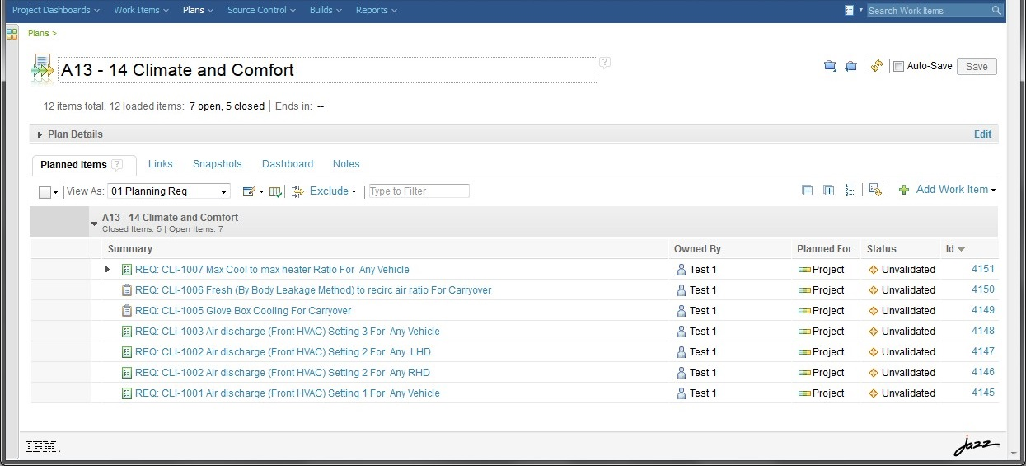
View Requirements in RTC Project Plan
The synchronised requirements are visible in the RTC Project plan for test planning

Slide 34
Exercise
Please complete the Unit 4 Exercise

Slide 35
Unit 5 – Writing Programme Requirements

Slide 36
Programme Specific Requirements
At programme start, the requirements module will already include all of the generic requirements owned by that team
Users can also create their own programme specific requirements, headings and information fields
The following attributes are mandatory when authoring a RMDV² requirement. (The system will not allow a user to transfer any requirements to RTC until all mandatory fields have been completed):
Requirement text - the requirement title and description
Object type – Requirement, Design Rule, Information, Heading
Requirement status – Draft or Released
Priority level – Legislation, brand, etc.
Requirement ID – this is auto-assigned by DOORS when the module is closed

Slide 37
Requirement Text
Requirement text should be added in the following format:
Requirement Title (Bold)
Requirement Text on next line
When requirements are synchronised to RTC for testing (below), the requirement title is used as the title for the requirement task. It is recommended practice to make the requirement title unique so that it can be easily identified in the test plan. (There is a 100 character limit for requirement titles)

Slide 38
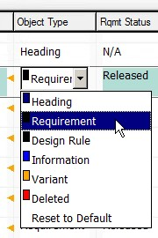
Object Type
Objects must be assigned a type as shown in the following table:
Object Type | Description
Requirement | Requirement
Design Rule | Requirement owned by Engineering (i.e. CAD Standards)
Heading | Document heading (i.e. 1.1, 1.2) (Does not get sent to RTC)
Information | Used for general module information. (Does not get sent to RTC)
Variant | System type (not used by users)
Deleted | Used to set a programme requirement to a deleted status (requirement is still available but not used)

Slide 39
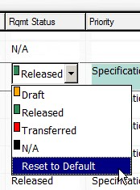
Requirement Status
New programme requirements (user created) have an initial status of Draft. When approved, their status is changed to Released.
Only requirements that have been placed in the Released state can be tested in RMDV² or linked to other requirements.
Requirement Status | Description
Draft | Initial status of a new requirement
Released | Requirement is approved and can be used for testing
N/A | Used for non-requirements such as headings and information
Transferred | When a requirement is transferred to another team, the original requirement is not deleted but changed to a Transferred state

Slide 40
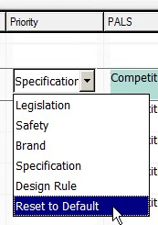
Priority Level
Requirements must be assigned a priority level as indicated in the following table (the highest priority is shown first in the table):
Priority Level | Description
Legislation | Requirements that if not met, will render the products uncertified (illegal) in one or more market(s) and will prevent vehicles from being registered Non-compliant products may not be dispatched from the vehicle assembly plant No deviations are allowed for legislation requirements
Brand | A minimum level of performance that defines the TML brand and brand DNA. A design or manufacturing strategy
Safety | Voluntary external agreement or code of practice, perhaps over and above the legislation Voluntary internal safety requirements or policy, perhaps over and above the legislation Requirements that avoid hazardous safety conditions to the service provider
Specification | A product related requirement below the level of Brand or Safety that still relates to customer satisfaction or proper vehicle function
Design Rule | An engineering standard

Slide 41
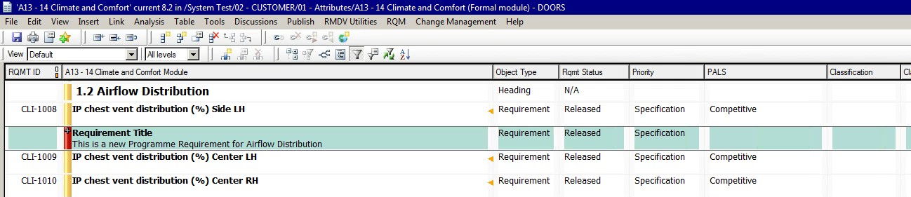
Creating a Programme Requirement in DOORS
Requirements can be authored in any DOORS view, but the default view contains the mandatory fields needed:
A new requirement is created by selecting the New requirement icon or by selecting the requirement where you want to create the new requirement and right click: Insert > Object
This provides an empty requirement at the selected location in the requirement module.
Requirements may be changed to headings (and vice-versa), using the Object text and Heading icons:
Object type
Req
Status
Priority
Requirement title and text
Requirement ID is assigned automatically when you Synchronise with RTC

Slide 42
Requirement Writing Checklist
For each requirement ask the question:
Is it correct? (asks for something possible, do-able, legal)
Is it complete? (a complete sentence, as discussed above)
Is it clear? (unambiguous and not confusing)
Is it consistent? (not in conflict with other requirements)
Is it verifiable? (can we determine that the system meets the requirement?)
Is it traceable? (uniquely identified and can be tracked)
Is it feasible? (accomplished within cost and schedule)
Concise
Design -independent
Traceable
Feasible
Consistent
Clear
Verifiable
Correct
Complete
Necessary
Unique
Atomic
Identified

Slide 43
Elements of a Good Requirement
Remember that a good requirement is built up of the following parts:
the subject (i.e. person or system);
the goal;
the object and
the measure of effectiveness (or qualifier)
the Constraint (if required)
Requirement examples
The communications system shall sustain communication with the caller for at least 60 minutes, while in the absence of external power
The user shall be able to view a product price within 10 seconds.
The marketing manager shall be able to analyze customer spending patterns for red widgets for a given period of time.
The feature shall display the 5 most recently entered destinations.

Slide 44
Examples of Poor Requirements
System shall provide a user-friendly interface
What’s user friendly? Who judges this?
System response time shall never exceed 4 seconds
Impossible to meet 100% of the time
Customer System Y shall provide reports per standard x.x.x.
We don’t specify what other systems will do. Say “Y will provide reports”
We “shall”; they “will”
System shall promptly inform the system administrator of faults
Is the sysadmin a part of our system or outside of it?
What constitutes promptly?
What types of faults fall under this requirement?
The requirement … must pass a test …
What test?

Slide 45
Exercise
Please complete the Unit 5 Exercise

Slide 46
Test Case Management in Rational Quality Manager
Unit 6 - RQM Basics

Slide 47
Rational Quality Manager (RQM) Login
Rational Quality manager contains all the generic and programme Test Cases and Test scripts for RMDV², and is accessed through your Personal dashboard widget
It is recommended that you bookmark these links for the training course
Your personal dashboard
https://tmlt.clm.ibmcloud.com/jts/dashboards/

Slide 48
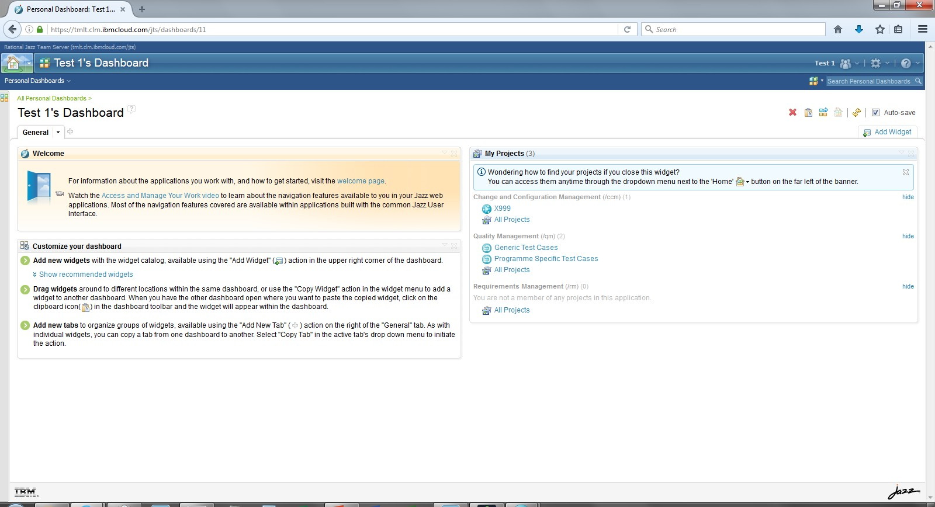
Personal Dashboard
Personal dashboards are accessed by the Home icon, which can display widgets from multiple projects (Including RTC and RQM)
Change and Configuration Management
This is the location for RTC Projects that you have been given access
Quality Management
This is the location for RQM libraries
Generic Test Cases holds the generic test case library
Programme specific test cases holds any programme created test cases

Slide 49
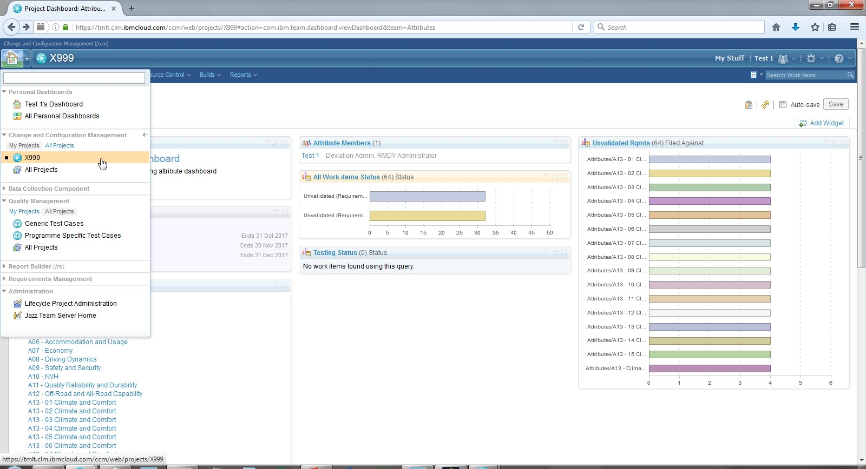
My Projects
You can also navigate to your projects by selecting the downward arrow next to the home icon

Slide 50
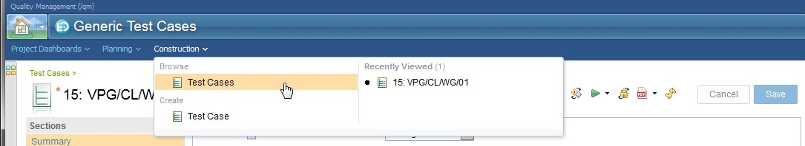
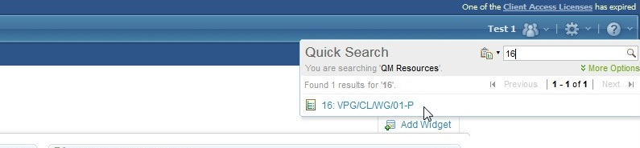
Browsing a Test Case Library in RQM
There are two test case libraries in RQM (Generic and Programme). These have the same purpose as the DOORS requirement libraries
Generic is the master library of test cases
Programme Specific is used for test cases created on a programme
Select the construction menu to view the list of generic cases: Construction > Browse > Test Case
Select the construction menu to create a test case: Construction > Create > Test Case
Use Quick Search if you know the test case name or number

Slide 51
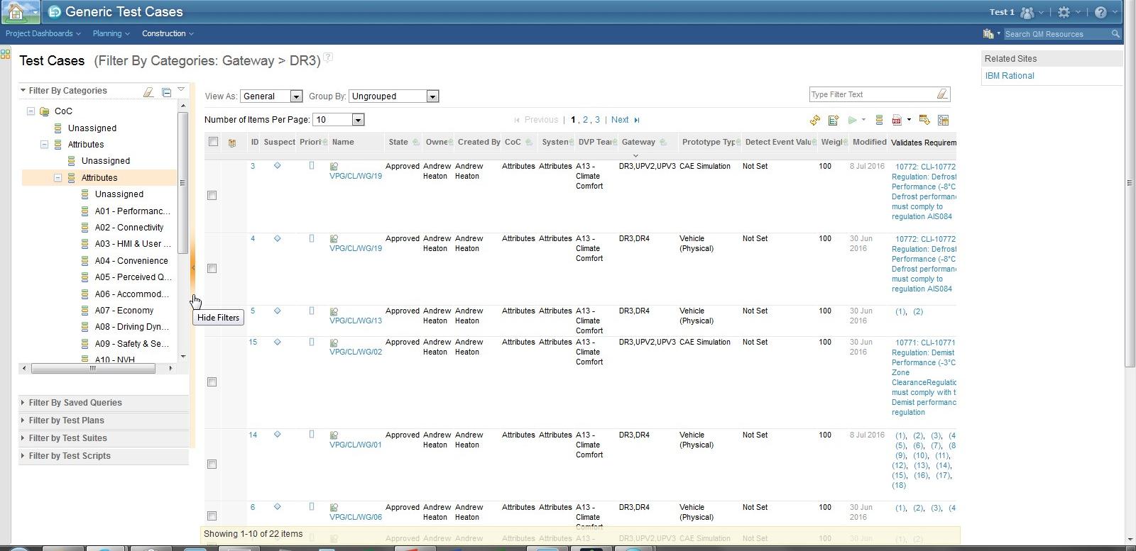
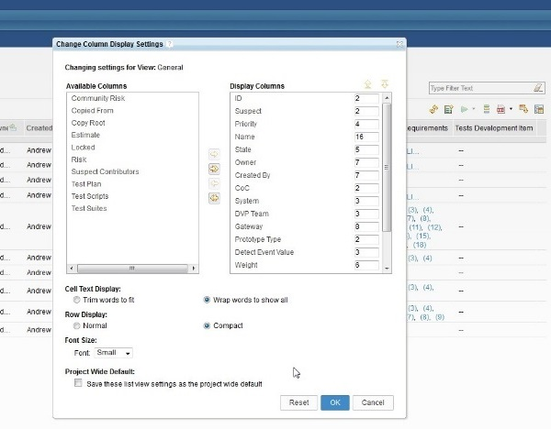
Viewing and Filtering Test Case Results
The default RQM view for displaying test cases often contains a number of columns. This can be made clearer by selecting the Change Column display settings icon and then Wrap words to show all, Compact, and Small font size. Unwanted columns can also be removed
Results can be filtered with the horizontal and vertical filter bars
Change Column Display Settings
Browse Test Cases
Filter

Slide 52

Test Case Sections
Test Case Detail section contains the main body of the test case, and can include hyperlinks to the test procedure in external systems.
Test Case Admin documents any supporting comments
Requirement Links are links from the test case to its associated requirement in DOORS
List of associated requirements
Attachments is used to save any supplementary information about the test case
Test scripts can be linked to the test case

Slide 53
Creating a Test Case - Test Case Summary
Every test case has a generic owner
The vehicle gateways where the test case is run.
Note: if this left blank, test cases will be created at project and will need to be manually planned
Prototype (Test) type (i.e. Vehicle (Physical), DFMEA, CAe Simulation)

Slide 54
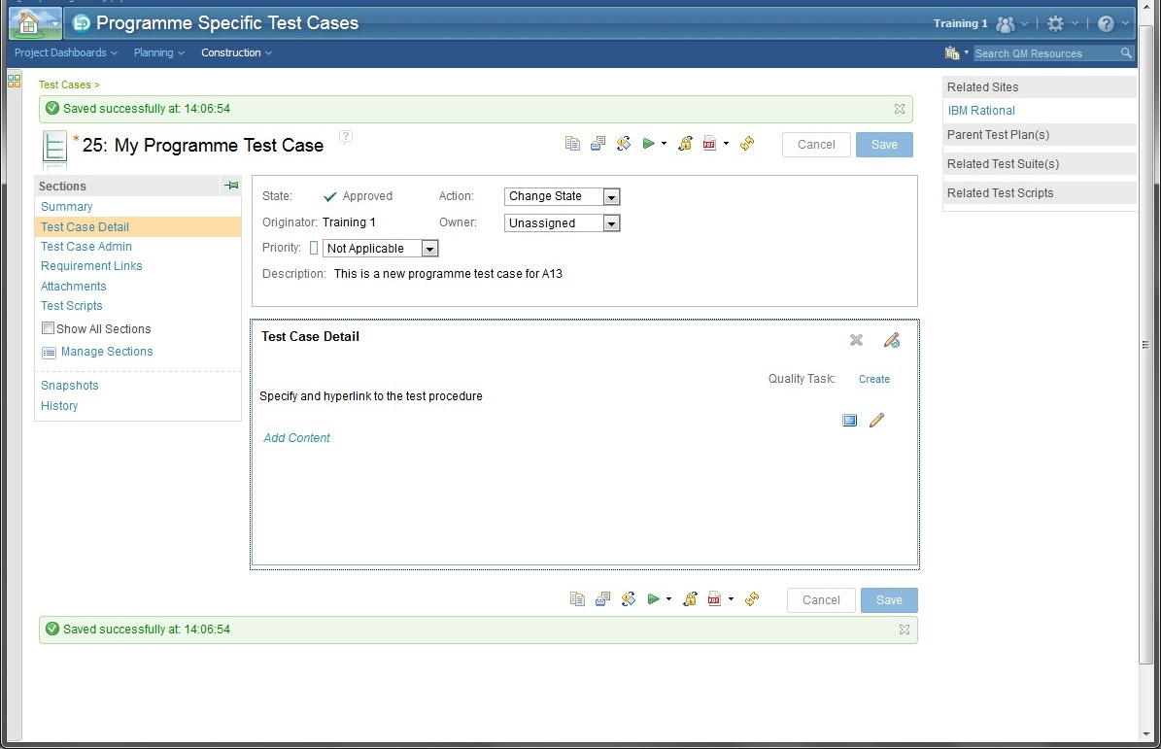
Creating a Test Case - Test Case Detail
Test Case Detail is where the test procedure is fully documented

Slide 55
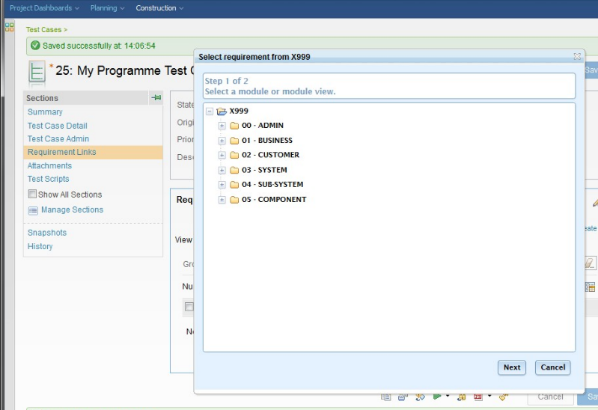
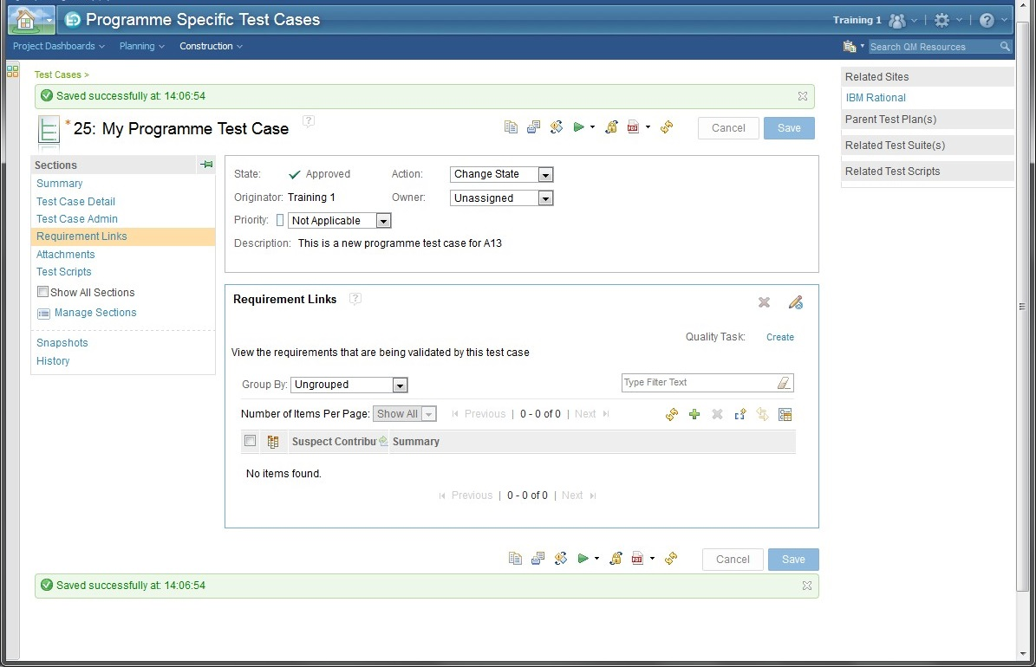
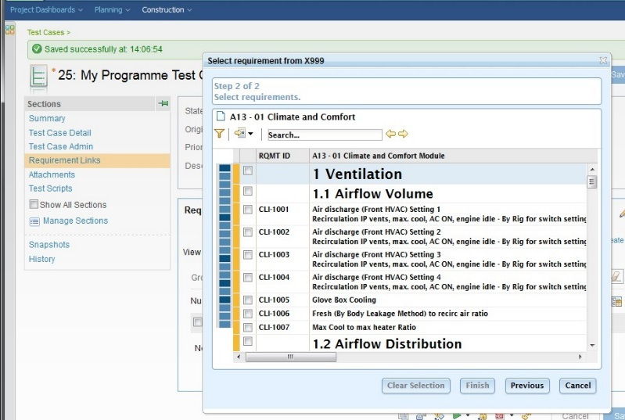
Creating a Test Case - Requirement Links
The RMDV² process requires every requirement to have at least one associated test case
3. Select the requirement module
1. Select the Requirement Links section
4. Select the requirement
2. Select (+) icon

Slide 56
Exercise
Please complete the Unit 6 Exercise

Slide 57
Unit 7 – RMDV² DOORS Views and Links

Slide 58
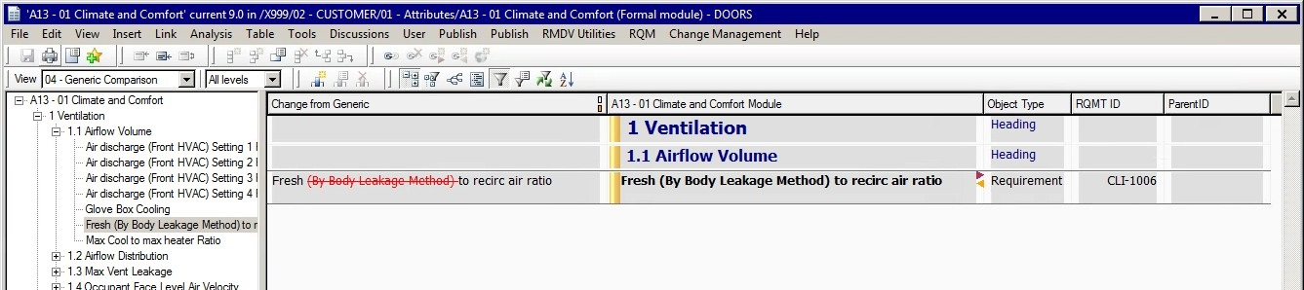
Views - 04 - Generic Comparison
In the 04 - Generic Comparison view you can inspect the programme module for any changes with its generic parent
The view will only show changed requirements, if there are no changes then the view will be empty
This column shows the Generic Requirement
This column shows the Programme Requirement
The text (By Body Leakage Method) has been removed from the generic requirement

Slide 59
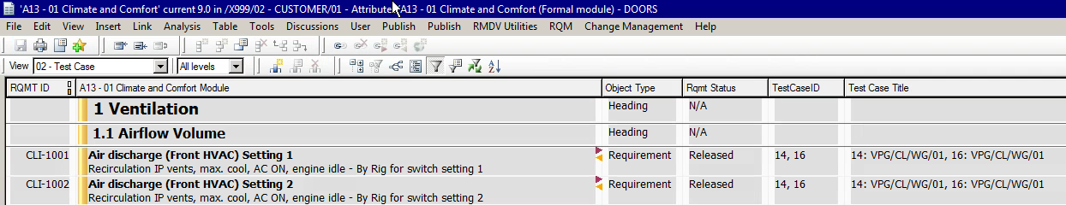
Views – 02 - Test Case
The test case view shows the requirements links to its associated test cases in RQM (Rational Quality Manager)
The TestCaseID is the RQM test case number
The Test Case Title is the title of the test case in RQM
When authoring programme requirements, the test case IDs should be populated before the requirement is synchronised to RTC
This is achieved (in DOORS) by selecting RMDV Utilities > RMDV Scripts > Update test case for this requirement after the test case has been linked to the requirement
Requirement is linked to two test cases in RQM: 14 and 16

Slide 60
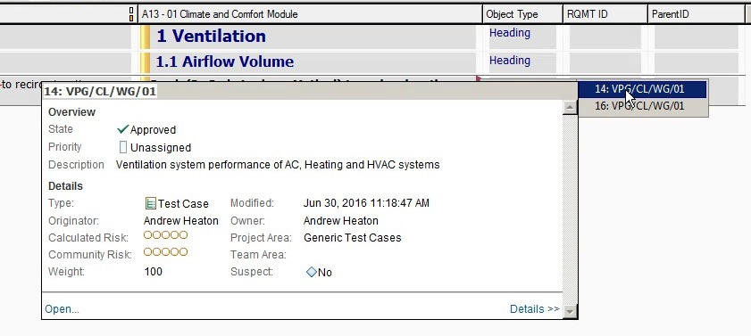
Navigating Object Links
An integral part of DOORS is the ability to view inbound and outbound links to other objects.
Objects with in or out links will be shown as icons on the requirement
Out link
In link
Selecting the in-link icon shows the link to the parent generic requirement
Selecting the out-link icon shows the links to test cases in RQM

Slide 61
Exercise
Please complete the Unit 7 Exercise

Slide 62

Recap
Requirements Management
Classify Requirements
Classify & add variants
Set targets
Author requirements
Send for testing

Slide 63
Test Planning and Reporting in Rational Team Concert
Unit 8 - RTC Basics

Slide 64
Rational Team Concert (RTC) Login
Rational Team Concert contains the planning, reporting and results for test cases used for requirement validation, and is accessed through your Personal dashboard widget
It is recommended that you bookmark these links for the training course
Your personal dashboard
https://tmlt.clm.ibmcloud.com/jts/dashboards/
RTC Project dashboard for training project X999
https://tmlt.clm.ibmcloud.com/ccm/web/projects/X999#action=com.ibm.team.dashboard.viewDashboard

Slide 65
Programme Plans and Dashboards
Plans are used to manage the scheduling of requirement and test tasks in a vehicle programme
The release plan manages the testing for the entire programme
The iteration plan manages the testing for a specific vehicle gateway
There are three levels of plan (L1 plans roll up all of the level 2 plans. Level 2 plans roll up all of the level 3 plans):
L1 – Project. This covers the entire programme and all teams
L2 – System. This covers the plan for a major system (i.e. Attributes, Electrical, Body)
L3 - DVP Team. This covers the plan for a individual team (i.e. A01, A12, Power Supply)
The status of a plan is shown on its dashboard, which is fully configurable

Slide 66
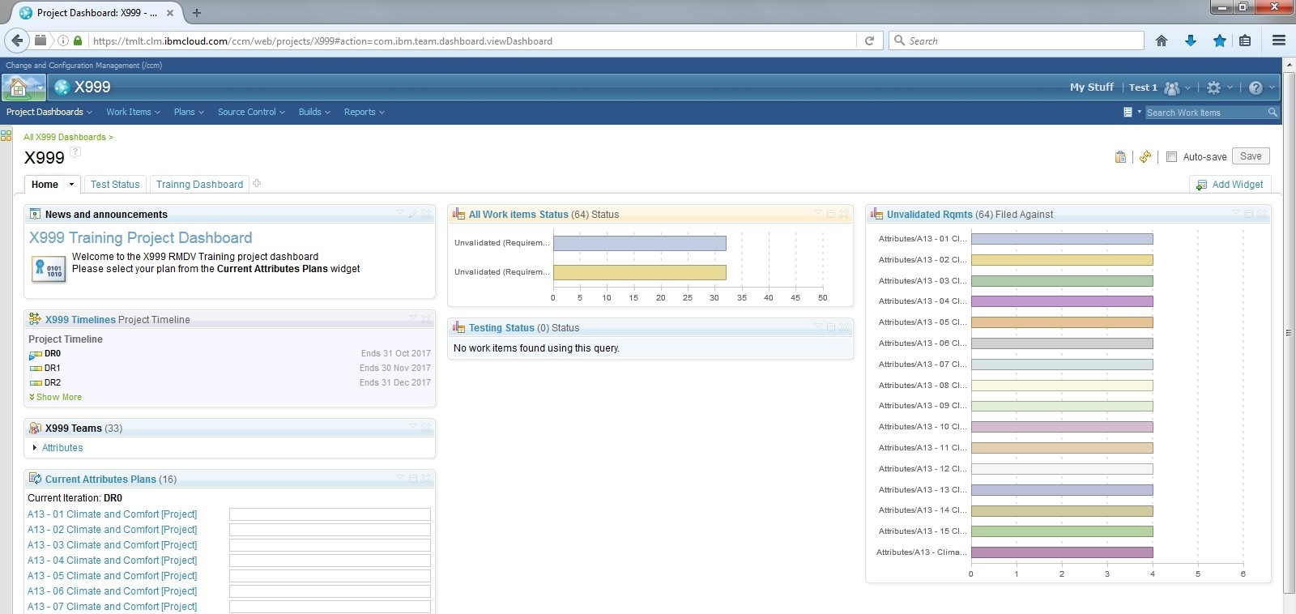
L1 - Project Dashboard
The Level 1 Plan is shown in the project dashboard
Tabbed Dashboards
Dashboard Widgets
Project Milestones
L2 - System Plans

Slide 67
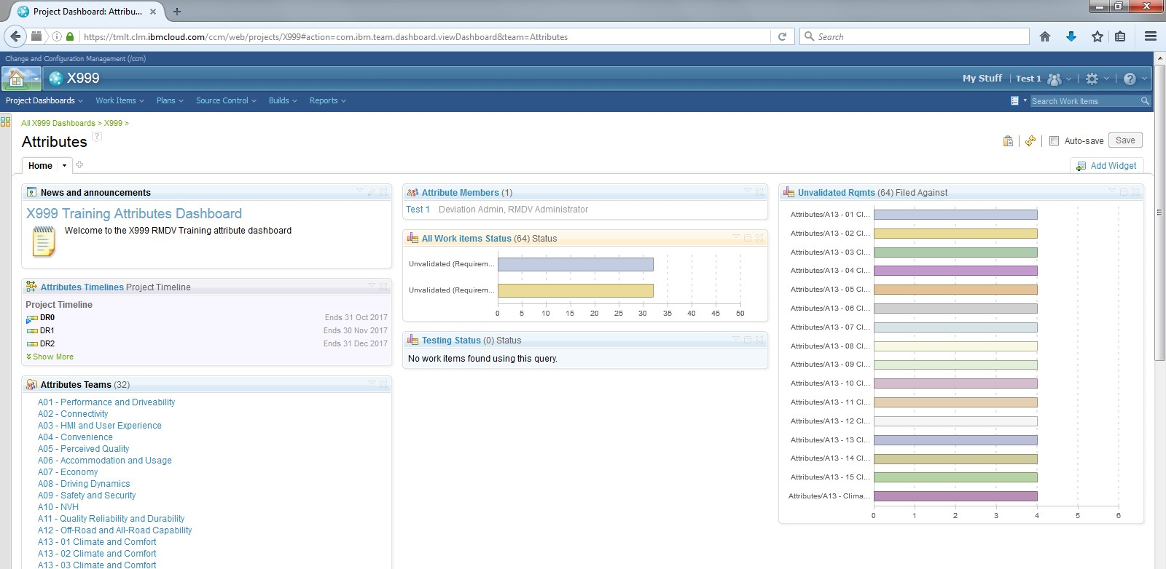
L2 - System Dashboards
Level 2 plans are shown in the system dashboards (with links to the L3 – DVP Team plans)
Use the breadcrumb menus to navigate back to the project dashboard
L3 – DVP Team Plans

Slide 68




Dashboard Widgets
Dashboard widgets show live views of the project status, and are selectable so individual work items can be shown

Slide 69

Rich Hover
Hovering over a work item name will bring up the rich hover menu, showing information about the work item
Selecting a Work Item will open it

Slide 70
Exercise
Please complete the Unit 8 Exercise

Slide 71
Unit 9 - RTC Work Items

Slide 72
Work Items
RMDV² uses work items (tasks) to manage the progression of testing throughout the vehicle programme
There are three major work items: Requirement Task, Requirement Carryover Task, and Test Task
Plan
Requirement
Validate
Requirement
The Requirement Task is used to track, manage and sign-off validated requirements for all specified variants
The requirement task is created when the DOORS module is synchronised with RTC.
The requirement task will have test task children
DR0 DR1 DR2
Programme Milestones
Requirement Task
Test Task A
Test Task C
Test Tasks are used to plan, manage and assess individual tests. They are associated to a parent requirement task and linked to test cases
Test tasks are created when the requirement task’s sign-off gateway is planned.
Test Case
Test Case
Test Task B
Test Case
Requirement Carryover Task
The Requirement Carryover Task is a variation of the requirement task.
It is used to and confirm that a requirement has been validated and signed-off on a previous vehicle programme; exempting the requirement for testing in the new programme.

Slide 73

Requirement Task
Requirement Task ID and Title (including variant)
Owning DVP team and Validation gateway
Information transferred from the DOORS requirement
Linked Test Case IDs for this requirement


Slide 74

Requirement Task (Contd)

Notes area for general information
Discussion area for team conversations, and auditable comments
Links to child test tasks
Links to related test cases (used in test tasks)
Link to the parent requirement in DOORS

Slide 75

Test Task
Test Task ID and Title (including variant)
Owning DVP team and Validation gateway
Test case information
(from RQM)
Test schedule information
Test report name and results
MiNT and deviations


Slide 76

Test Task (Contd)

Upload test result documents
Discussion area for team conversations, and auditable comments
Links to parent requirement task
Link to associated test case

Slide 77

Requirement Carryover Task
Requirement Carryover Task ID
Owning DVP team and Validation gateway
Information transferred from the DOORS requirement
Carryover Vehicle Line and Model Year
Upload test result documented evidence

Slide 78

Tasks Shown in a Project Plan
Requirement tasks are shown as:
REQ + Requirement Title + Req Variant
Items with Strikethroughs have been resolved
Test Tasks are shown as:
Test Case ID + Test Case Title
Separate Requirement tasks are created for each variant with a unique target.
Note: CLI-1002 has 2 tasks with targets for both LHD and RHD feature variants

Slide 79


Work Item Workflows
Each work item has its own workflow for resolution
Requirement Task Workflow
Test Task Workflow

Slide 80
Unit 10 – Create Test Tasks (DVP Creation)

Slide 81
Process Step 2: Create Test Tasks
Requirement tasks can be planned for testing within a plan or by opening the individual task
The benefit of planning the individual task is that the user retains control on which test tasks are created
Open Project Plan
or
Open Requirement Task
Multi-Select Requirement Task(s)
(Optional) Add / Remove
Generic Test Case IDs **
Set Planned For (Gateway)
+ Save Task / Plan
Initially all requirement tasks transferred from DOORS are planned against the project
It is important to plan the requirement to its validation gateway – as this generates the test tasks
** Use if you want to review or modify the generic tests cases for a requirement
Test Tasks
Generated
All Test Tasks
have Gateways?
No
Test tasks are planned against a gateway to ensure that the DVP plan is complete. (Note, most of these will be pre-populated)
There is no need to schedule the actual dates for the test until its planned gateway is current.
Open Test Task
Yes
Set Planned For (Gateway)
End of Test Plan Creation
2. Create Test Tasks

Slide 82

Project Plan – 01 Planning Req view
This is the default view for planning and viewing the plan
Plan Name
Plan save
View
Filter
Task Owner
Due Date
Task
Task Status
Work Item ID

Slide 83

Project Plan – 04 My Plan Items view
This view shows only the tasks owned by you, and is very useful for filtering large plans with multiple users

Slide 84


Create Test Tasks from the Project Plan
2. Save the plan
1. Select the planned for gateway for the requirement
By default, the system only shows the next 4 gateways in the programme timeline
To plan for any gateway, click on the work item icon on the left of the task, then Plan # Plan Items For > Browse
Note: If you select the tick box to the left of the work item icon you can multi-select and bulk plan items

Slide 85

Create Test Tasks from the Project Plan (Continued)
3. Expanding the Requirement task will display the newly generated test tasks

Slide 86

Create Test Tasks from a Requirement Task
2. Save the task
1. Select the planned for gateway for the requirement
Add additional test cases will create a single test task set to project
Select Add Pre-defined Gateway to generate multiple test tasks assigned to their generic gateways
Manually add or remove test cases (using RQM test case IDs)
Select View Generic Test Cases to view the test cases without generating a task
Optionally, you can add or remove test cases before they are generated

Slide 87


Requirement Task Links
At the bottom of each requirement task its links to other objects are shown (each link can be navigated to its source object)
Test Task Links
(RTC)
Test Case Links
(RQM)

Slide 88
Exercise
Please complete the Unit 10 Exercise

Slide 89
Unit 11 – Schedule Tests

Slide 90
Process Step 3: Schedule Tests
Open Test Task / Plan
Test tasks are scheduled at the start of their planned for gateway
The scheduled start and end dates must be planned within the gateway, otherwise a MiNT has to be raised and documented in the system
Tests that are no longer required are changed in status to Not Applicable
Add Scheduled Start Date
Add Scheduled Finish Date
End of Test Scheduling
Note, the system will not let you schedule a date beyond its gateway without a MiNT ID recorded
3. Schedule Tests

Slide 91

Schedule Tests
4. Save the plan
1. Select the 02 Planning Tests view (or open the test task)
2. Tests no longer required are changed to Not Applicable
3. Select dates for the scheduled start and end of the test

Slide 92
Exercise
Please complete the Unit 11 Exercise

Slide 93
Unit 12 – Run Tests

Slide 94

Process Step 4: Run Tests
Open Test Task /Plan
When tests are run, their status is updated to Start Working
Set Status to
Start Working
Actual Start Date Set
Run Test
4. Run Tests

Slide 95

Run Tests
3. Save the plan
1. Select the 02 Planning Tests view (or open the test task)
2. Change the status to Start Working
Status changes to Start Working
Actual Start date is automatically set

Slide 96
Exercise
Please complete the Unit 12 Exercise

Slide 97
Unit 13 – Capture Test Results

Slide 98
Process Step 5: Capture Test Results
Open Test Task
Not Met
Test
Result?
Met
To record a Target Met, a mandatory test report has to be attached as evidence
Set Status to
Target Not Met
Set Status to
Target Met
Add Test Report Details and Upload Evidence
Add Test Report Details and Upload Evidence
To record a Target Not Met, a mandatory MiNT ID and possible deviation number is required in additional to be test report
Enter MINT / Deviation Plan Number
Actual Finish Date Set
Actual Finish Date Set
Test tasks that have been set to Target Not Met can be retested, by selecting Retest in the task status.
Test tasks that are retested retain their original test reports and change history for audit purposes.
Set Status to
Retest
5. Capture Test Results

Slide 99

Record a “Target Met” Result
1. Set the status to Target Met
5. Save the task
3. Enter Test Result Details
(i.e. actual result =2m/s +/- 0.5)
2. Enter a Test Report Number
4. Upload a Test Report

Slide 100

Record a “Target Not Met” Result
1. Set the status to Target Not Met
6. Save the task
3. Enter Test Result Details
(i.e. Result achieved =22 kmpl is less than target of 25 kmpl)
2. Enter a Test Report Number
5. Enter a MiNT ID
4. Upload a Test Report
Next step: Target Not Met + Target Deviation

Slide 101

Record a “Target Deviation”
1. Set the status to Target Deviation
3. Save the task
2. Enter a Deviation Number
Next step: Target Not Met + Deviation Approve / Reject

Slide 102

Approving or Rejecting a Target Deviation
Only a Deviation Administrator can approve a deviation
Before a deviation is approved, the user must confirm that all open MiNTs are closed
Any user can reject a deviation
A rejected deviation status returns to Target Not Met for retesting
2. Set the status to Deviation Approved
2. Save the task
1. Confirm MiNTs are closed

Slide 103
Exercise
Please complete the Unit 13 Exercise

Slide 104
Unit 14 – Validate Requirements

Slide 105
Process Step 6: Validate Requirements
No
All Tests Complete?
Yes
Yes
Open Requirement Task
A requirement task can only be validated when each of the test tasks have reached a resolved state
Set Status to Validated
Open Requirement Carryover Task
Enter Carryover Model Year and Evidence
A requirement carryover task can only be validated when the user has and confirmed that the requirement has been validated on a previous vehicle programme
Set Status to
Carryover Validated
6. Validate Requirements

Slide 106

Validate Requirement Task
2. Save the plan
1. Change the status to Validate
A requirement task can only be validated when all its test tasks are in a resolved state (strikethrough)

Slide 107

Validate Carryover Requirement Task
3. Save the task
1. Change the status to Validate
2. Review the carryover conditions and set the carryover vehicle from the menu

Slide 108
Exercise
Please complete the Unit 14 Exercise

Slide 109
Recap
Verification and Validation
Create Test Tasks (DVP Creation)
Schedule Tests
Run Tests
Capture Test Results
Validate Requirements

